Slide 1

MACHINE LEARNING
LOAN PREDICTION

Slide 2

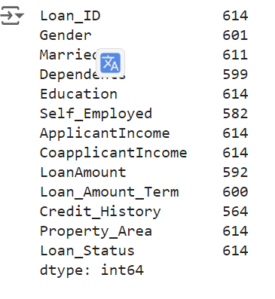
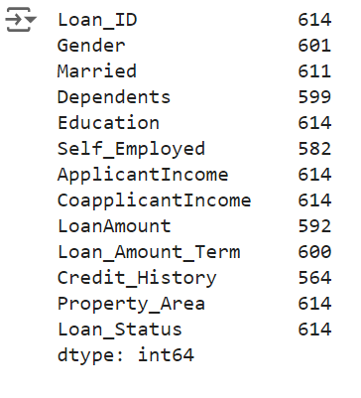
INTRODUCTION
DATA SET

Slide 3
INTRODUCTION
DATA SET
DATA SET
PREPROCESSING
ANALYSIS
MODEL

Slide 4

INTRODUCTION
DATA SET
DATA SET
LOAN PREDICTION
PREROCESSING
ANALYSIS
YES
NO
MODEL

Slide 5
PREPROCESSING
MISSING VALUE
Fill in the most common value
OUT LINERS
Isolation Forest Algorithm

Slide 6
PREPROCESSING
MISSING VALUE
Fill in the most common value
OUT LINERS
Isolation Forest Algorithm
ANALYSIS
Explore Data: Special points affect the model initialization process
Analyze the correlation between variables

Slide 7
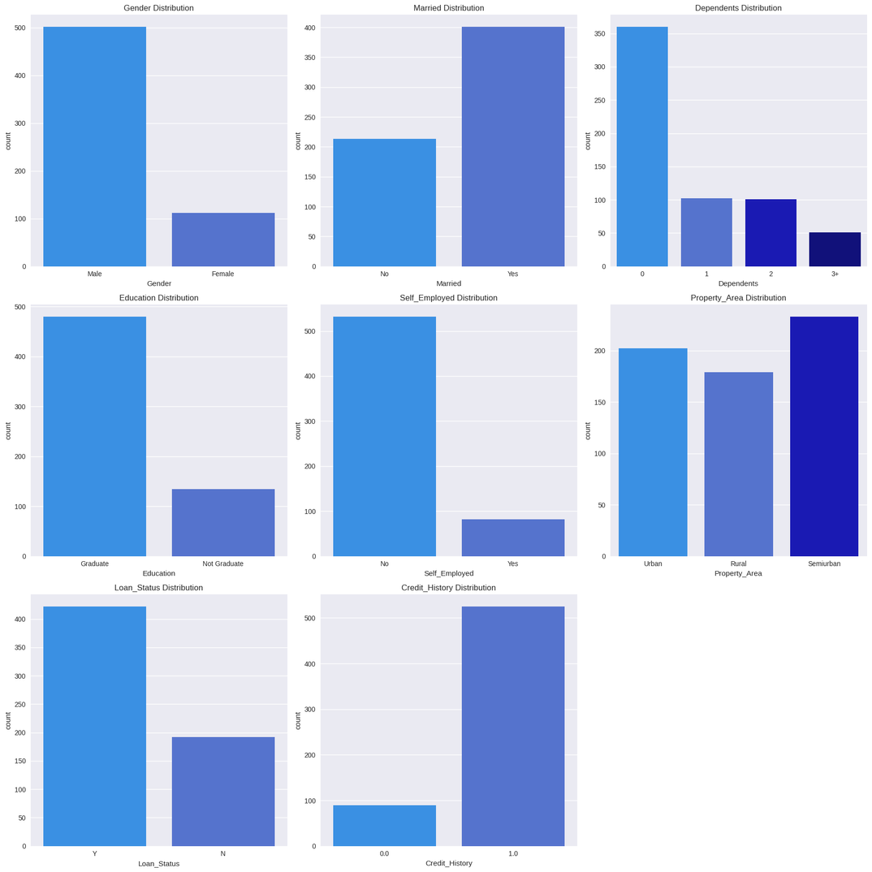
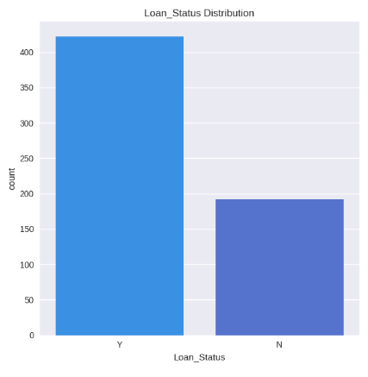
EXPLORE DATA:
CATEGORICAL VARIABLES
CATEGORICAL VARIABLES
Imbalance data
LOAN PREDICTION

Slide 8
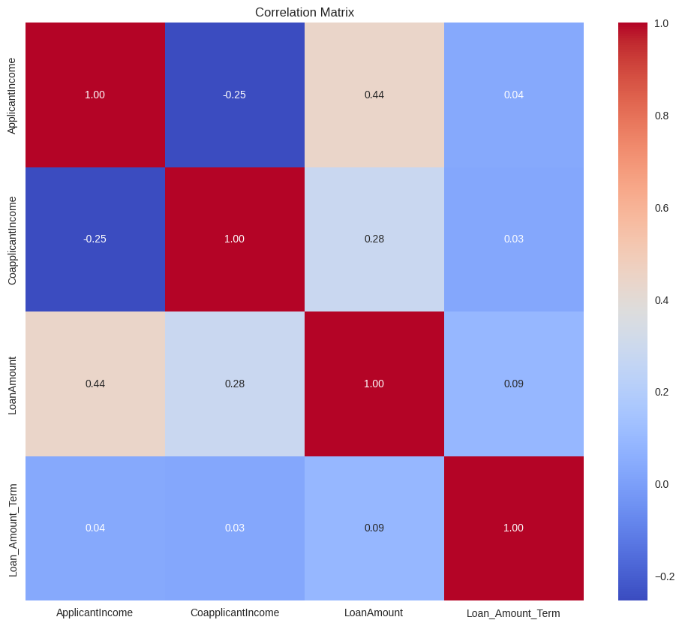
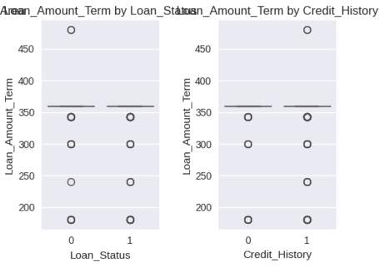
CORRELATION
Box Plot
PEARSON
CONTINUOUS - CATEGORY

Slide 9
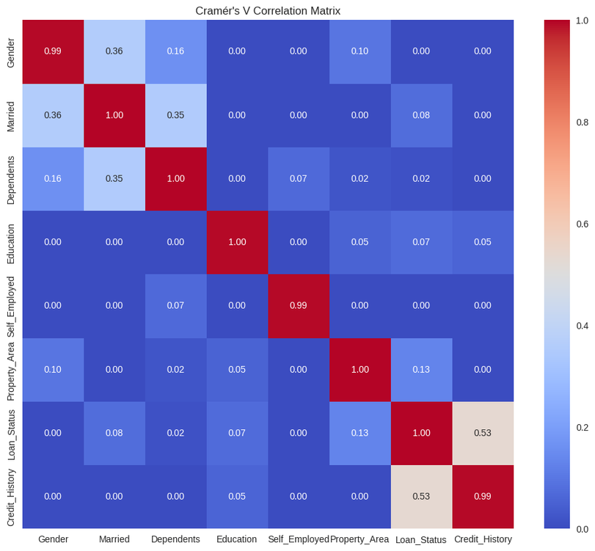
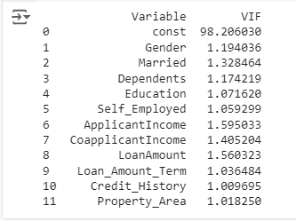
CORRELATION
MULTICOLLINEARITY
CRAMER’V
VARIANCE INFLATION FACTOR

Slide 10
LOGISTIC
REGRESSION
RANDOM
forest classifier
ALGORITHM
SUPPORT
VECTOR MACHINE
XGBOOST
CLASSIFIER

Slide 11
LOGISTIC
REGRESSION
RANDOM
forest classifier
ALGORITHM
SUPPORT
VECTOR MACHINE
XGBOOST
CLASSIFIER
GRID SEARCH CV
Test all combinations of hyperparameters
Cross-Validation evaluates the model's performance

Slide 12
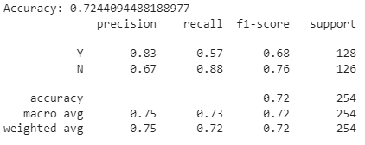
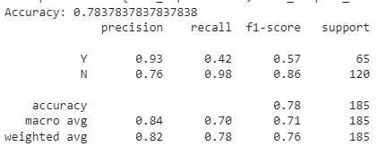
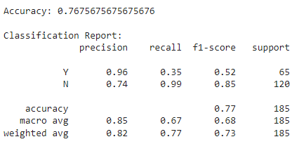
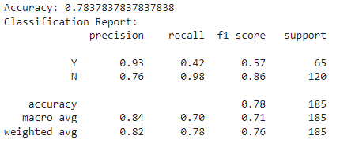
LOGISTIC
REGRESSION
RANDOM
forest classifier
PERFORMANCE EVALUATION
SUPPORT
VECTOR MACHINE
XGBOOST
CLASSIFIER

Slide 13

LOGISTIC
REGRESSION
RANDOM
forest classifier
PERFORMANCE EVALUATION
SUPPORT
VECTOR MACHINE
XGBOOST
CLASSIFIER

Slide 14
LOGISTIC
REGRESSION
RANDOM
forest classifier
PERFORMANCE EVALUATION
SUPPORT
VECTOR MACHINE
XGBOOST
CLASSIFIER

Slide 15
EXPLORE DATA:
CATEGORICAL VARIABLES
CATEGORICAL VARIABLES
Imbalance data
LOAN PREDICTION

Slide 16
LOGISTIC
REGRESSION
RANDOM
forest classifier
RESAMPLING
PERFORMANCE EVALUATION
SUPPORT
VECTOR MACHINE
XGBOOST
CLASSIFIER

Slide 17
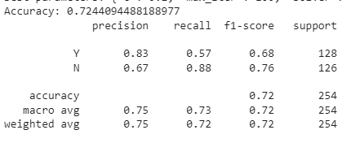
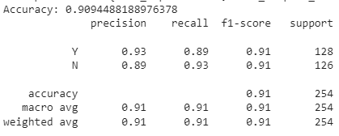
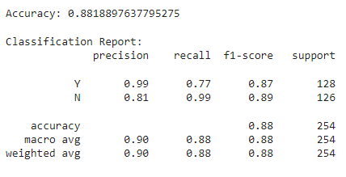
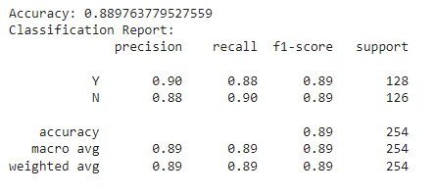
LOGISTIC
REGRESSION
RANDOM
forest classifier
RESAMPLING
PERFORMANCE EVALUATION
SUPPORT
VECTOR MACHINE
XGBOOST
CLASSIFIER

Slide 18
LOGISTIC
REGRESSION
RANDOM
forest classifier
RESAMPLING
PERFORMANCE EVALUATION
SUPPORT
VECTOR MACHINE
XGBOOST
CLASSIFIER

Slide 19
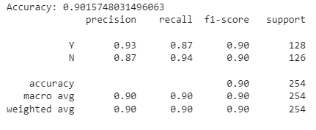
RANDOM
forest classifier
RESAMPLING
XGBOOST
CLASSIFIER
PERFORMANCE EVALUATION

Slide 20
RANDOM
forest classifier
RESAMPLING
XGBOOST
CLASSIFIER
PERFORMANCE EVALUATION
TIME TO FIND HYPER PARAMECTERS = 218.709S
TIME TO RUN = 0.875S
TIME TO FIND HYPER PARAMECTERS = 3551.733S
TIME TO RUN = 1.581S

Slide 21
RESAMPLING
RANDOM
forest classifier
PERFORMANCE EVALUATION

Slide 22
RESAMPLING
PERFORMANCE EVALUATION
PIPE LINE

Slide 23
PIPE LINE
Original data
PREPROCESSING
CREATE MODEL
PREDICT

Slide 24
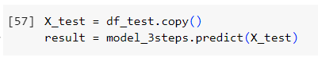
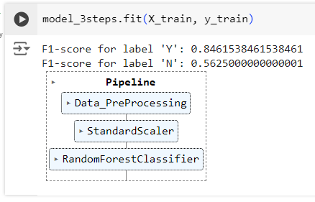
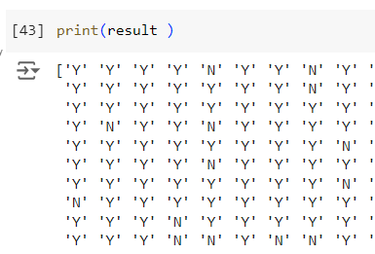
PIPE LINE

Slide 25
PIPE LINE

Slide 26
THANK YOU
FOR YOUR ATTENTION

